Slide 1
The Revelation of Jesus Christ
Vision 5 (20:1-10) - Satan Bound, Satan Loosed, Satan Conquered

Slide 2
The Symmetry of Revelation 12-20
Chapter 12: Satan persecutes the church
Chapter 13: the beast and false prophet persecute the church
Chapters 14-18: judgment of the beast and false prophet
Chapter 19: victory over the beast and false prophet
Chapter 20: victory over Satan

Slide 3
“And we have the prophetic word more fully confirmed, to which you will do well to pay attention as to a lamp shining in a dark place, until the day dawns and the morning star rises in your hearts,”
–2 Peter 1:19

Slide 4
Revelation 20:1-3
Then I saw an angel coming down from heaven, having the key to the bottomless pit and a great chain in his hand. He laid hold of the dragon, that serpent of old, who is the Devil and Satan, and bound him for a thousand years; and he cast him into the bottomless pit, and shut him up, and set a seal on him, so that he should deceive the nations no more till the thousand years were finished. But after these things he must be released for a little while.

Slide 5
What John Saw
“key” = the power/authority to open or close
“bottomless pit” = Tartarus, the abyss, the deepest pit of Hades (see 2 Peter 2:4)
“bound” = to limit or restrict power (Matthew 12:29, Luke 11:22)
An angel binds Satan: Satan, while powerful, is from the angelic hosts
“that he should deceive the nations no more” = only one aspect of his power is limited

Slide 6
When is Satan Bound?
Revelation 12:9: Satan exiled from heaven, cast to the earth; he “deceives the whole world”
Revelation 13:14: the false prophet who looks like a lamb but talks like a dragon “deceives those who dwell on the earth”
Revelation 13: the beasts prevail for 1,260 years
Revelation 11:1-14: the Reformation concludes the 1,260 years

Slide 7
God binds Satan’s power to deceive the nations during the time of the Reformation.

Slide 8
What signals his release?
Revelation 16:13-14, “And I saw three unclean spirits like frogs coming out of the mouth of the dragon…For they are spirits of demons, performing signs, which go out to the kings of the earth and of the whole world, to gather them to the battle of that great day of God Almighty.”
Revelation 20:7-8, “Now when the thousand years have expired, Satan will be released from his prison [8] and will go out to deceive the nations which are in the four corners of the earth, Gog and Magog, to gather them together to battle, whose number is as the sand of the sea.”

Slide 9
Satan was released to deceive the nations in the early 20th century.

Slide 10
One thousand in Scripture
Deuteronomy 7:9, “Therefore know that the LORD your God, He is God, the faithful God who keeps covenant and mercy for a thousand generations with those who love Him and keep His commandments;”
Joshua 23:10, “One man of you shall chase a thousand, for the LORD your God is He who fights for you, as He promised you.”
Psalms 50:10, “For every beast of the forest is Mine, And the cattle on a thousand hills.”
“one thousand” = a large, but indeterminate, number

Slide 11
one thousand years in Scripture
Psalms 90:4, “For a thousand years in Your sight Are like yesterday when it is past, And like a watch in the night.”
Ecclesiastes 6:6, “even if he lives a thousand years twice—but has not seen goodness. Do not all go to one place?”
2 Peter 3:8, “But, beloved, do not forget this one thing, that with the Lord one day is as a thousand years, and a thousand years as one day.”
“one thousand years” = a long time from our perspective, a short time from God’s perspective

Slide 12
Different views of the Millennium
Premillennial: Jesus returns, Satan bound, Jesus reigns for 1,000 years, Satan loosed, Armageddon, judgment day
Postmillennial: the gospel is spread throughout the world, Satan is bound, the world is ruled under Christian authority for 1,000 years, Satan loosed, Armageddon, Jesus returns, judgment day
A-millennial: Satan is bound, 1,000 years is symbolic, Satan is loosed, Armageddon, Jesus returns, judgment day.

Slide 13
Revelation 20:4-6
And I saw thrones, and they sat on them, and judgment was committed to them. Then I saw the souls of those who had been beheaded for their witness to Jesus and for the word of God, who had not worshiped the beast or his image, and had not received his mark on their foreheads or on their hands. And they lived and reigned with Christ for a thousand years. But the rest of the dead did not live again until the thousand years were finished. This is the first resurrection. Blessed and holy is he who has part in the first resurrection. Over such the second death has no power, but they shall be priests of God and of Christ, and shall reign with Him a thousand years.

Slide 14
What john saw
“thrones” = reigning with Christ
“judgment was committed to them” = the saints will judge the world (see 1 Corinthians 6:2)
“the souls of those who had been beheaded” = disembodied saints between death and the bodily resurrection (remember 6:9)
Those who remained true to God during the 1,260 years
The 144,000 — see 14:1-5 and 15:2-4

Slide 15
resurrection of the soul - John 5:24-25
“Most assuredly, I say to you, he who hears My word and believes in Him who sent Me has everlasting life, and shall not come into judgment, but has passed from death into life. Most assuredly, I say to you, the hour is coming, and now is, when the dead will hear the voice of the Son of God; and those who hear will live.”

Slide 16
resurrection of the body — John 5:28-29
“Do not marvel at this; for the hour is coming in which all who are in the graves will hear His voice and come forth—those who have done good, to the resurrection of life, and those who have done evil, to the resurrection of condemnation.”

Slide 17
Two deaths
Death of the body: Hebrews 9:27, “And as it is appointed for men to die once, but after this the judgment,”
Death of the soul:
Revelation 20:14, “Then Death and Hades were cast into the lake of fire. This is the second death.”
Matthew 10:28, “And do not fear those who kill the body but cannot kill the soul. But rather fear Him who is able to destroy both soul and body in hell.”

Slide 18
Two deaths, two resurrections
First resurrection: the soul of the one who hears, believes, and obeys (John 5:24-25)
First death: the body of everyone who dies before the return of Jesus (Hebrews 9:27)
Second resurrection: the bodies of the righteous and the wicked (John 5:28-29)
Second death: the destruction of body AND soul in hell (Revelation 20:14 and Matthew 10:28)

Slide 19
putting it all together
Disembodied souls
Their souls were made alive upon belief, repentance, and baptism (the first resurrection)
After their body dies, their souls live and reign with Christ until the bodily resurrection
They remained true to the Lord and died for their faith during the reign of the beast (verse 4)
Their presence with Jesus assures us of their victory over Satan (see Revelation 12:11)
They will judge those who cooperated with the beast, worshipped his image, etc.

Slide 20
Timeline
100’s to 300’s — apostasy metastasizes
300’s to 1500’s — 1,260 days/42 months/time, times, and 1/2 time
Beast and false prophet prevail over the church
144,000 remain true to the Lord and die for their faith
1500’s to early 1900’s — the millennium
Satan is bound
Martyrs live and reign with Christ

Slide 21
Verse 5
Verse 4 contrasts those sealed by God and those who received the mark of the beast
“the rest of the dead” — those who worshipped the beast and his image and who received his mark
“lived not again until the thousand years were finished”
The resurrection of the body (John 5:28-29) will happen after the millennium
If you cooperate with the beast, there is no life after death

Slide 22
Verse 6
Those who experience the “first resurrection” are “blessed and holy”
The “second death has no power” — avoid eternal condemnation
They remain “priests of God and Christ”
They will reign with Christ
The faithful have nothing to fear and much to anticipate!

Slide 23
Revelation 20:7-8
Now when the thousand years have expired, Satan will be released from his prison and will go out to deceive the nations which are in the four corners of the earth, Gog and Magog, to gather them together to battle, whose number is as the sand of the sea.

Slide 24
“If one were writing the history of Western Europe in the period from about 330-700 AD, there would, inevitably be two major themes. The first would tell of the late Roman empire and its fate after the reorganization by the Emperors Diocletian and Constantine, until most of its Western provinces were superseded by barbarian kingdoms. The second theme would be the story of these new nations, the Germanic kingdoms whose foundations were laid during the years from about 400-600 AD.”
– The Oxford Illustrated History of Christianity, p. 62

Slide 25
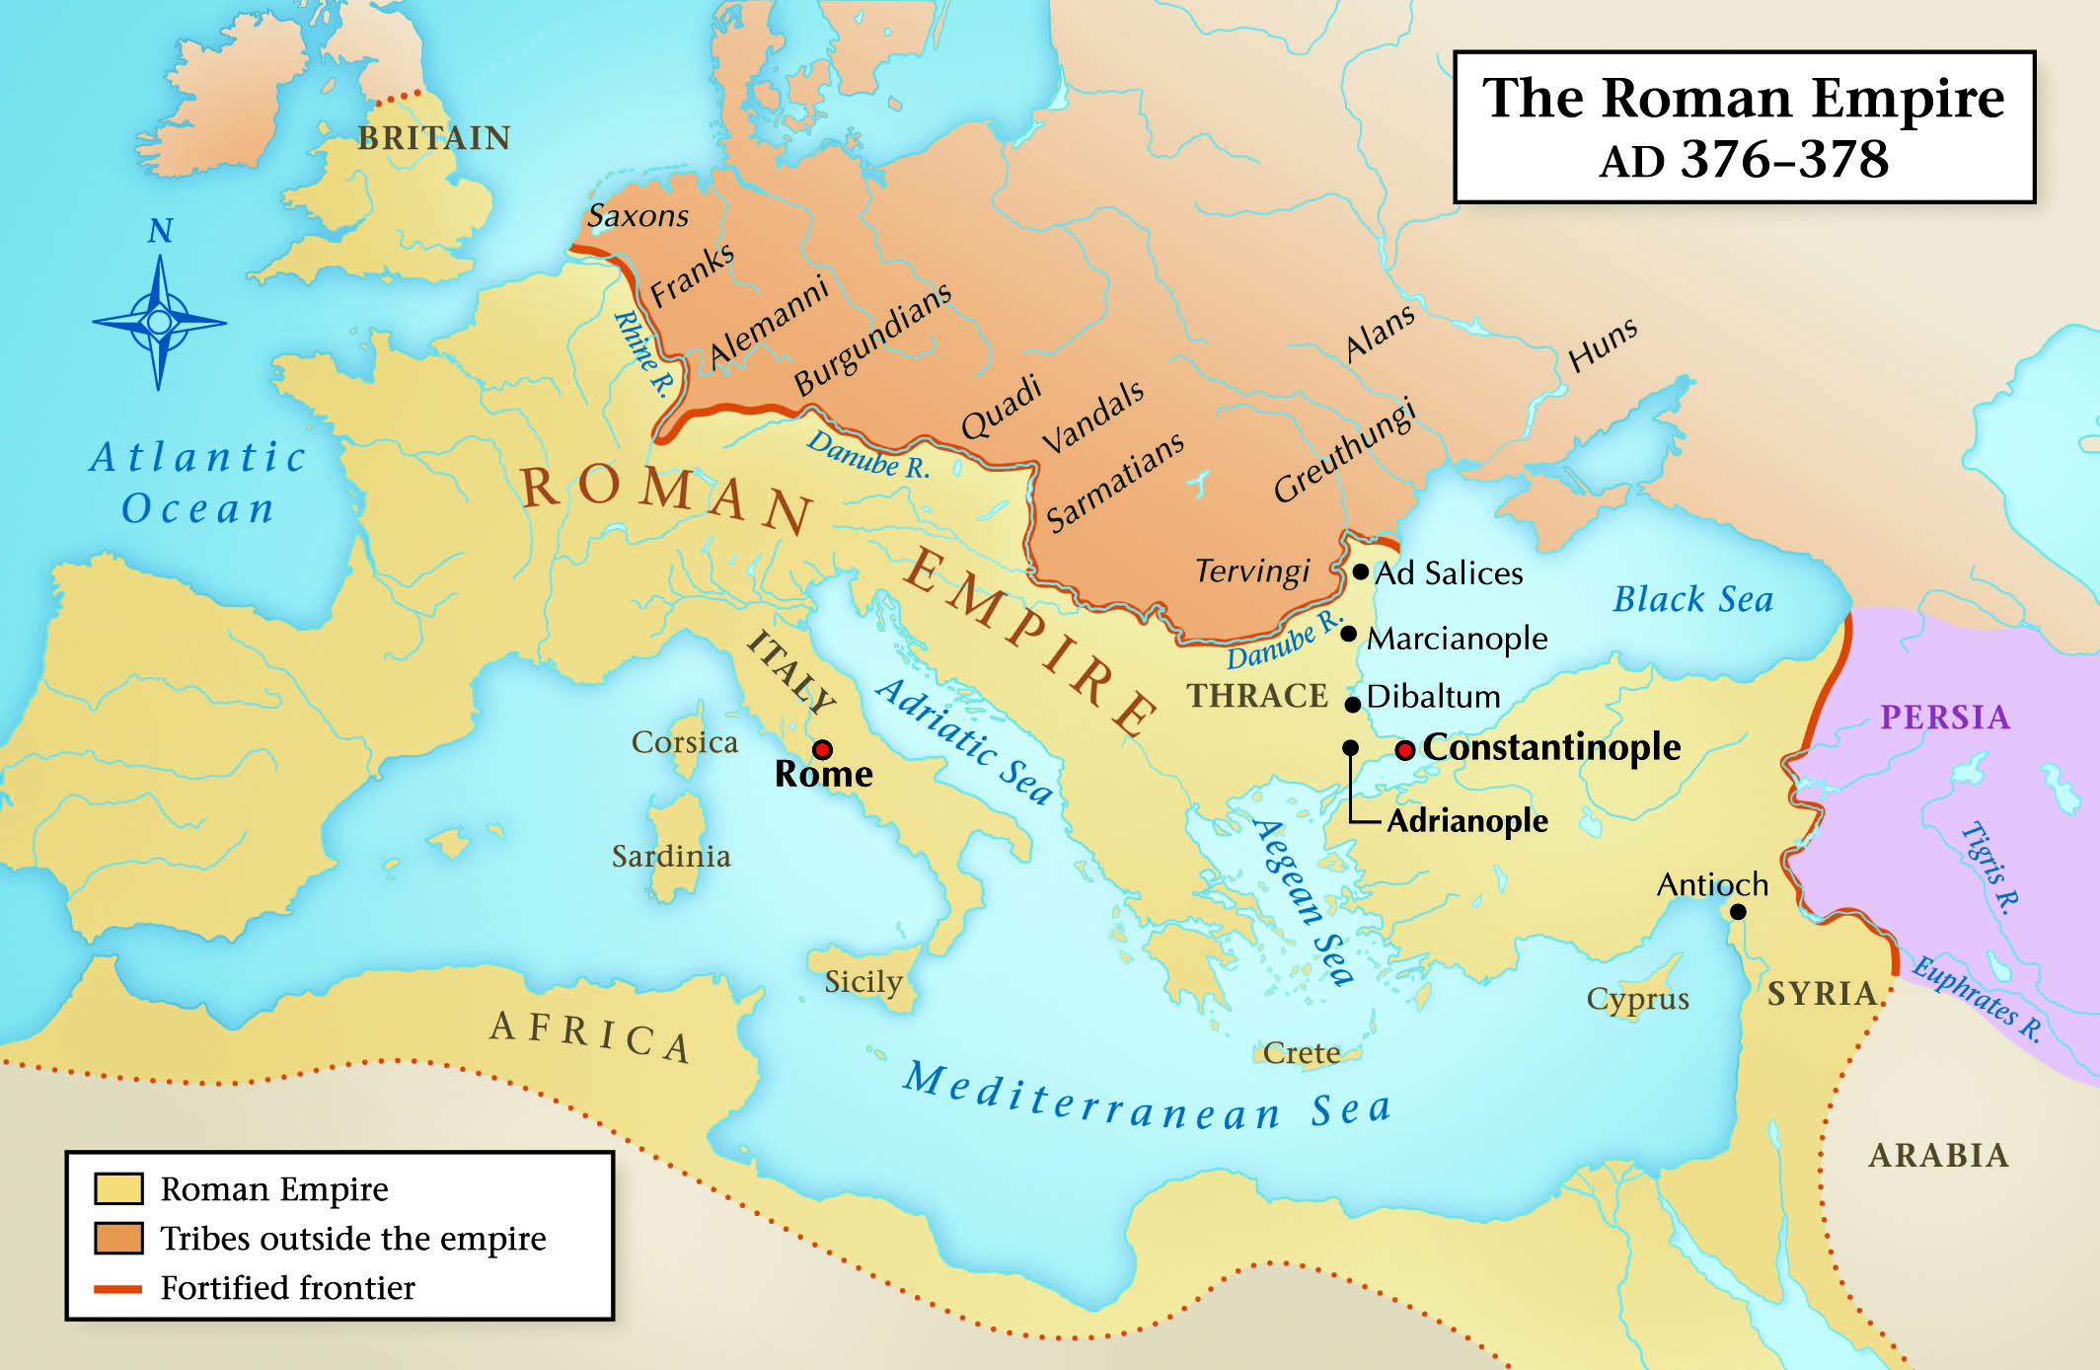

Slide 26
“Gog and Magog”
Ezekiel 38:2, “Gog” = a prince from the land of Magog
Magog
Second son of Japheth
Josephus: “Magog founded the Magogians, thus named after him, but who by the Greeks are called Scythians.”
Collection of nomadic tribes, dominated Central Asia

Slide 28
A Savage Reputation
IV Maccabees 10:7 (first century A.D.), “And being in no way able to choke his spirit, they flayed off his skin with the tips of his fingers and stripped off his scalp as the Scythians do.”
Josephus, “But even Scythians, who delight in murdering people and are little better than wild beasts, nevertheless think it their duty to uphold their national customs.”
Colossians 3:11, “where there is neither Greek nor Jew, circumcised nor uncircumcised, barbarian, Scythian, slave nor free, but Christ is all and in all.”

Slide 29
Connection with the Goths
Scythians slowly declined after the Sarmatians defeated them in 310 B.C.
Conquered and absorbed by the Goths in the late 300’s A.D.
Greeks used Scythians as a general term to refer to the Sarmatians, Alans, and Goths
“Gog” may represent the Goths

Slide 30
Notes:
“Visigoths” = Western Goths
“Ostrogoths” = Eastern Goths

Slide 31
What do “Gog and Magog” represent?

Slide 32
A Hypothesis
“Gog and Magog” = domain of the beast, the ten horns, the European powers
The ten horns: “They will make war on the Lamb, and the Lamb will conquer them, for he is Lord of lords and King of kings, and those with him are called and chosen and faithful” (Revelation 17:14)
“On his robe and on his thigh he has a name written, King of kings and Lord of lords…And I saw the beast and the kings of the earth with their armies gathered to make war against him who was sitting on the horse and against his army” (Revelation 19:16, 19)
European-led efforts toward total globalization since the end of WW2

Slide 35
Revelation 20:9-10
They went up on the breadth of the earth and surrounded the camp of the saints and the beloved city. And fire came down from God out of heaven and devoured them. The devil, who deceived them, was cast into the lake of fire and brimstone where the beast and the false prophet are. And they will be tormented day and night forever and ever.

Slide 36
What John Saw
The armies of the world surround:
“the camp of the saints”
“the beloved city” — Jerusalem, the church
“fire came down from heaven” — at the moment Satan’s victory seems secure, the church will be delivered by the power of God (see 2 Thessalonians 1:8)
“the devil…was thrown into the lake of fire and sulfur” — condemned to hell for all eternity

Slide 37
Armageddon
16:13-14: the dragon, the beast and the false prophet gather the world against the church
19:19-21:
The world is assembled in opposition to Christ
Jesus leads the armies of heaven against the beast and false prophet, they are condemned to hell
20:9-10
The world is assembled in opposition to the church
God delivers the church at the last moment

Slide 38
What should we expect?
Things will seem normal from the world’s perspective — Luke 17:26-30
Dwindling numbers of Christians (days of Noah and Lot, Luke 18:8)
Persecution
Does the church need to be in one location to be surrounded?

Slide 39
Proleptic visions of the Judgment day
Revelation 2-3: each letter to the seven churches alludes to the return of Christ
Revelation 11:15-19: the seventh trumpet
Revelation 14:14-20: the harvesting of the righteous and the trampling of the wicked
Revelation 19:17-21: the judgment of the beast and false prophet
Revelation 20:10-15: Satan condemned, the world is judged

